Slide 1
Presentation On ICT and related technologies
01/01/2024

Slide 2

ICT Final project

Slide 3




Table Of Contents
Introduction to ICT
Information and Communication Technologies(definition)
Google Services
Microsoft Tools
Git and GitHub
Benefits of ICT Tools
Conclusion

Slide 4

1. Introduction to ICT 2. Information and Communication Technologies(definition) 3. Google Services 4. Microsoft Tools 5. Git and GitHub 6. Benefits of ICT Tools 7. Conclusion

Slide 5
Introduction to ICT
Today, computing is commonplace. It's obvious that it's been adopted by us as a regular part of our professional and personal lives, as a result of advances in the telecommunications field, Information and Communication Technologies (ICT) are now experiencing a rapid increase in development. ICT combines all of the technologies and instruments used to process (hardware and software) as well as communicate (communication networks) information in digital form. This concerns the majority of areas of our daily lives, including education, transportation, commerce, the medical and military fields, nothing can function without it. As a student, it's important to know how to utilize specific ICT tools.

Slide 6
1. Introduction to ICT 2. Information and Communication Technologies(definition) 3. Google Services 4. Microsoft Tools 5. Git and GitHub 6. Benefits of ICT Tools 7. Conclusion

Slide 7
Information and communication technologies(definition)
.
.
ICT, or information and communications technology (or technologies), is the infrastructure and components that enable modern computing
Among the goals of IC technologies, tools and systems is to improve the way humans create, process and share data or information with each other.

Slide 8
1. Introduction to ICT 2. Information and Communication Technologies(definition) 3. Google Services 4. Microsoft Tools 5. Git and GitHub 6. Benefits of ICT Tools 7. Conclusion

Slide 9
Google Services
Google search
Gmail
Google calendar
Google Maps
Google Photos
Youtube
- The world's most popular search engine, providing users with quick and relevant search results.
- A widely used email service with a user-friendly interface, and seamless integration with other Google services.
- A web-based calendar application that helps users organize their schedules, events, and appointments.
- A mapping service that provides directions, traffic conditions, and local business information
- A cloud-based service for storing and sharing photos and videos. It includes features like automatic backup.
- A video-sharing platform where users can upload, share, and view videos. It covers a wide range of content.

Slide 10
Google Services
Google Chrome
Google Meet
Google Drive
Google Classroom
Google Ads
Google Analytics
- A web browser developed by Google known for its speed, simplicity, and security features.
- A video conferencing service that allows users to host virtual meetings, webinars, and collaborative sessions.
- A cloud storage service that allows users to store and share files, documents, photos, and videos.
- An online platform designed for teachers and students to facilitate communication and collaboration.
- An online advertising platform where businesses can create and manage ads to reach their target
- A web analytics service that provides insights into website traffic and user behavior.

Slide 11
1. Introduction to ICT 2. Information and Communication Technologies(definition) 3. Google Services 4. Microsoft Tools 5. Git and GitHub 6. Benefits of ICT Tools 7. Conclusion

Slide 12
Microsoft Tools
WORD
Excel
PowerPoint
Microsoft Word is a word processing application developed by Microsoft as part of the Microsoft Office suite. It is one of the most used word processors in the world, providing users a bunch of tools and features for creating, editing, and formatting documents.
Microsoft Excel is a powerful spreadsheet application developed by Microsoft as part of the Microsoft Office suite, it is widely used in data analysis, computing, visualization and information organization. Excel is an important tool in many sectors such as finance, business and education.
The Microsoft Office suite also include a presentation software called PowerPoint It facilitates users in creating interesting visualizations with text, images, and multimedia using the multiple features that the software includes and that for various purposes.

Slide 13
1. Introduction to ICT 2. Information and Communication Technologies(definition) 3. Google Services 4. Microsoft Tools 5. Git and GitHub 6. Benefits of ICT Tools 7. Conclusion

Slide 14
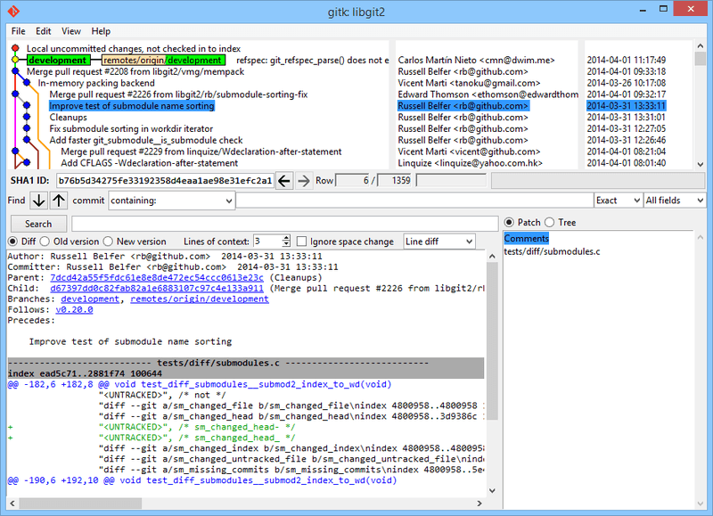
Git and GitHub
Git:
Git is a distributed version control system (VCS) designed to handle everything from small to very large projects with speed and efficiency. Git has become the de facto standard for version control, especially in the open-source community. It enables developers to track changes, collaborate seamlessly, and maintain a history of their codebase.
Git graphic interface :

Slide 15
Some of it concepts:
Repository:
A Git repository, is a collection of files and directories along with the version history information stored by Git
Commit:
A commit represents a snapshot of the changes made to the codebase at a specific point in time. Each commit has a unique identifier.
Branch:
A branch is a separate line of development. Git allows branching, enabling developers to work on features or bug fixes without affecting the main codebase. Branches can be merged back when the changes are ready.
Merge:
Merging combines changes from different branches. It can be done manually or automatically by Git when changes do not conflict.
Pull Request:
In Git-based collaboration, a pull request is a proposed set of changes. It allows others to review and discuss the code before merging it into the main codebase.

Slide 16


The most popular Git hosting platform is GitHub.
Git has become an integral part of modern software development, playing a crucial role in enabling teams to work efficiently, collaborate seamlessly, and maintain a robust history of their codebases. Its flexibility and scalability make it suitable for projects of all sizes.
GitHub:
GitHub is a web-based platform built on top of Git, the distributed version control system. Launched in 2008, GitHub has become the go-to platform for developers, providing tools for version control, collaboration, code review, and project management. It has played a pivotal role in fostering open-source development and supporting distributed teams worldwide.

Slide 17
1. Introduction to ICT 2. Information and Communication Technologies(definition) 3. Google Services 4. Microsoft Tools 5. Git and GitHub 6. Benefits of ICT Tools 7. Conclusion

Slide 18


Benefits of ICT Tools
Improved Communication
Increased Efficiency
Increasing Motivation
Innovation and Creativity
ICT facilitates instant communication through emails, messaging apps, video conferencing
By improving communications and coordination through various tools This leads to increased efficiency
By providing interactive and engaging learning experiences and also getting quick feedback on own work.
ICT tools provide platforms for innovation and creative expression. From software development to many fields.

Slide 19
1. Introduction to ICT 2. Information and Communication Technologies(definition) 3. Google Services 4. Microsoft Tools 5. Git and GitHub 6. Benefits of ICT Tools 7. Conclusion

Slide 20
THANKS!
Hope you liked the presentration
Final projet

